Slide 1
Evaluation of Hyponatremia
3 factors to evaluate:
1 Sodium levels mEq/L
2 Tonicity (osmolality): compared with other molecules
3 Volume
Na mEq/L: | Hypo-natremia < 130 mEq/L | Normal Na 135 – 145 mEq/L | Hyper-natremia > 150 mEq/L
Osmolality/Tonicity: | Hypotonic < 280 mOsm/kg | Iso-tonic 280-295 mOsm/kg | Hyper-tonic > 295 mOsm/kg
Notes:
The terms are different because osmolarity takes into account the total concentration of penetrating solutes and non-penetrating solutes, whereas tonicity takes into account the total concentration of only non-penetrating solutes

Slide 2
1. Assess Na (mEq/L):
<-------------------------- 135 ---------------------- 145 --------------------------->
HyPOnatremia
Normal
HyPERnatremia
2. Assess Osmolality (mOsm)
<--------------------------- 280 ---------------------- 295 -------------------------- >
HyPOtonic
Isotonic
hyPErtonic

Slide 3
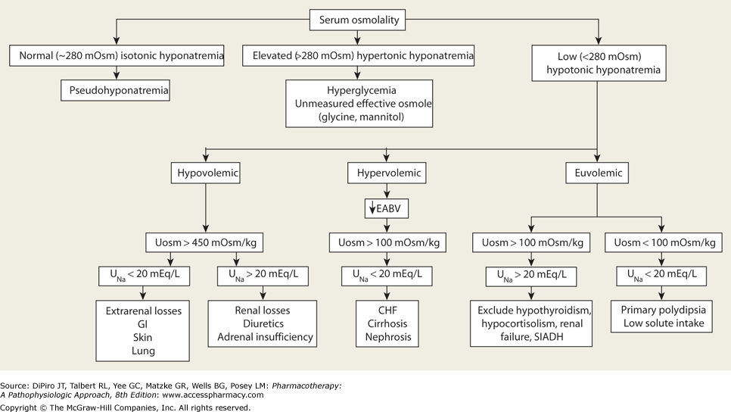
Sodium Homeostasis: Matrix mOsm with mEq

Slide 4
Sodium Homeostasis: Matrix mOsm with mEq
 | Hypo-Natremia | mOsm/kg | Cell
Isotonic | Cause: Pseudohyponatremia: Na Hyperlipidemia or hyperproteinemia Na: Low b/c hyponatremia Tonicity: balances out | 80-295 mOsm/kg | normal
Hyper-tonic | ⬇ Na ⬆⬆ Glucose (hyperglycemia) Na: low b/c hyponatremia Tonicity: shrinks b/c HypERglycemia If Glucose > 100, use Corrected Na | > 295 mOsm/kg | shrinks
Hypo-tonic | Hypovolemic: Low Na, Low fluid Hypervolemic: High Na, Very high fluid Euvolemic: | < 280 mOsm/kg Swells | swells
Glucose - 100
Corrected Na = Na + 1.7 *
100

Slide 5
Hypotonic Hyponatremia

Slide 6
Hypo-Tonic
Hypo-Natremia
Assess Hypotonic Hyponatremia
Then
Assess Volumes
 | Hypo-volemic Hypotonic Hyponatremia | Eu-volemic Hypotonic Hyponatremia | Hyper-volemic Hypotonic Hyponatremia
Description | ⬇Na ⬇Fluid | ↔Na from ADH ⬆Fluid from ADH | ⬆Na can’t eliminate ⬆⬆Fluid can’t eliminate
Result | Fluid follows Na |  | Fluid dilutes Na
Cause | Thiazides GI loss (diarrhea) | SSRI SIADH | CHF, Renal
S/S | Thirst |  | Edema
Chronic Tx |  | Remove SIADH +/- If chronic, Demeclocycline | Water Restriction + +/- Loop
Acute Tx | If Na 115-130 then NS If Na < 115 then 3%Na | Vaptans | Vaptans
Notes:
Demeclocycline inhibits ADH

Slide 7
General Tx of HyPO-natremia: NS
Check Na Levels
Mild 115 - 130 mEq/L
Severe: < 115 mEq/L
0.9% NS
3% NS
Do not increase serum sodium by more than
10- 12 mEq/L in 24 hours
Or
1 mEq/hr
in order to avoid osmotic demyelination syndrome
Monitor Serum Na q2-4 hours
Monitor q4-6 hours:
Urine Na, Urine Osm, K for the first 24 hours

Slide 8
 | Conivaptan (Vaprisol®) | Tolvaptan (Samsca)
Indication | Euvolemic and hypervolemic hyponatremia in hospitalized patients | Euvolemic and Hypervolemic hyponatremia (associated with HF, cirrhosis, or SIADH) with either Na < 125 mEq/L or less marked hyponatremia that is symptomatic and resistant to fluid restriction
Mechanism of Action | V1 & V2 receptor antagonist | V1 & V2 receptor antagonist
Dose | 20 mg IV loading dose (over 30 min) , followed by continuous IV infusion of 20mg/ 24 hours x 4 days | 15 mg PO once daily after at least 24 hours may ↑ to 30 mg once daily (max of 60 mg once daily)
Drug Interactions | Substrate of CYP 3A4 and a potent inhibitor of 3A4 | Substrate of CYP 3A4 and P-glycoprotein
Adverse reactions | Injection-site reactions, hypokalemia, orthostatic hypotension, and headache | Dry mouth, nausea, excess thirst, polyuria, and generalized weakness
Contraindications | Hypovolemic hyponatremia, concurrent use with strong CYP 3A4 inhibitors (i.e. ketoconazole, itraconazole, ritonavir, clarithromycin); anuria | Hypovolemic hyponatremia; urgent need to raise serum sodium acutely, use in patients unable to sense or appropriately respond to thirst; anuria; concurrent use with strong CYP 3A4 inhibitors

